Slide 1



Wind Farm Challenge by Anemo Analytics
Notes:
Check background color darkness

Slide 2

How Renewable can we go?
27%
Notes:
Circle diagram

Slide 3


How Renewable can we go?
100%
Notes:
Circle diagram

Slide 4
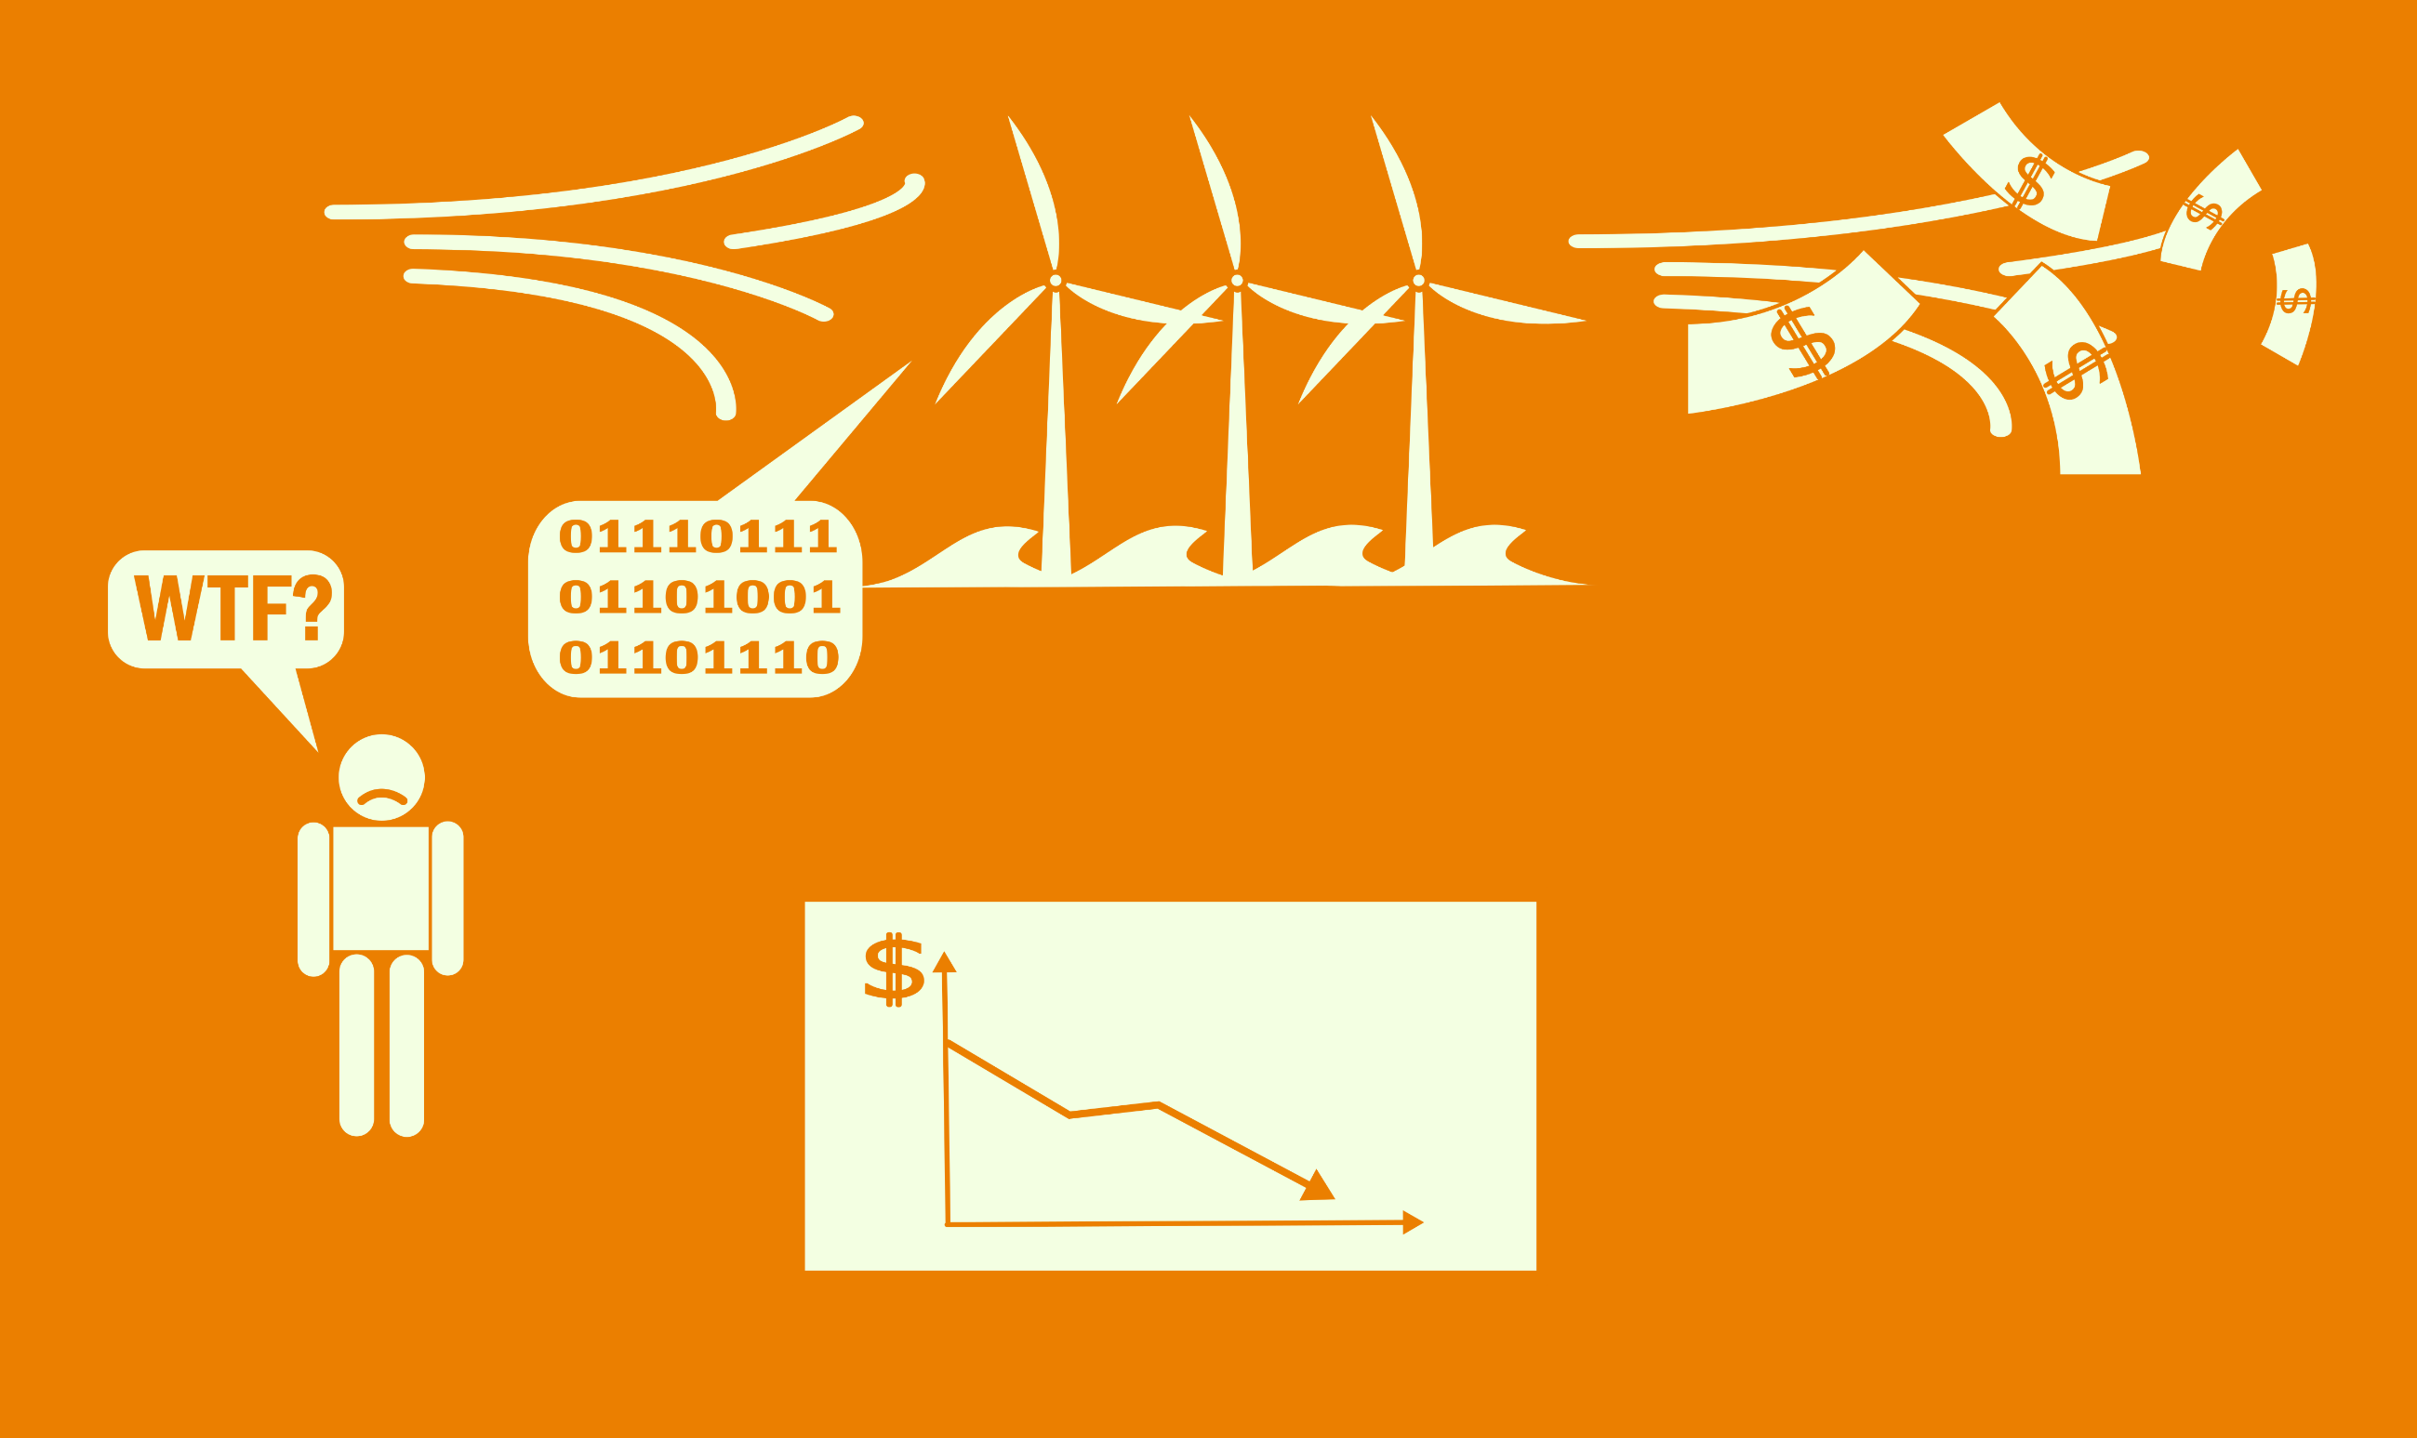


The Problem
Notes:
Adjust picture downward

Slide 5
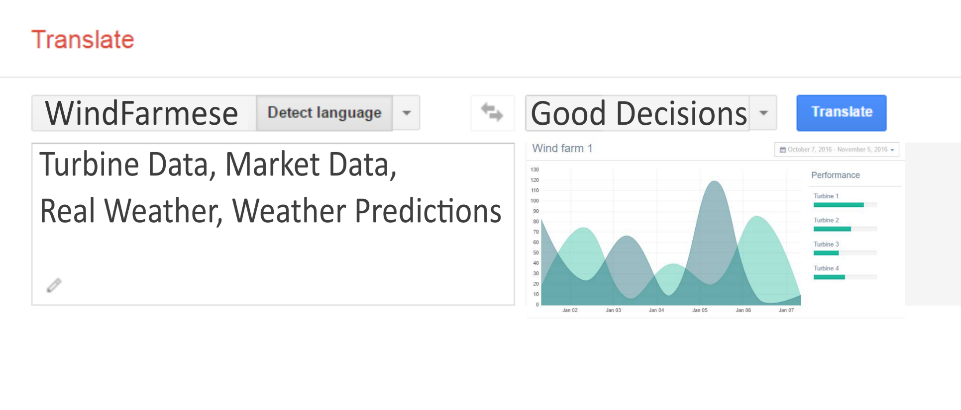
The Solution

Slide 6

The Solution
Real-time farm setup
Increase in production
Maintenance plan
Saving on maintenance
Accurate prediction
Increase in sales
Notes:
Fix animation

Slide 7

Website Demo

Slide 8

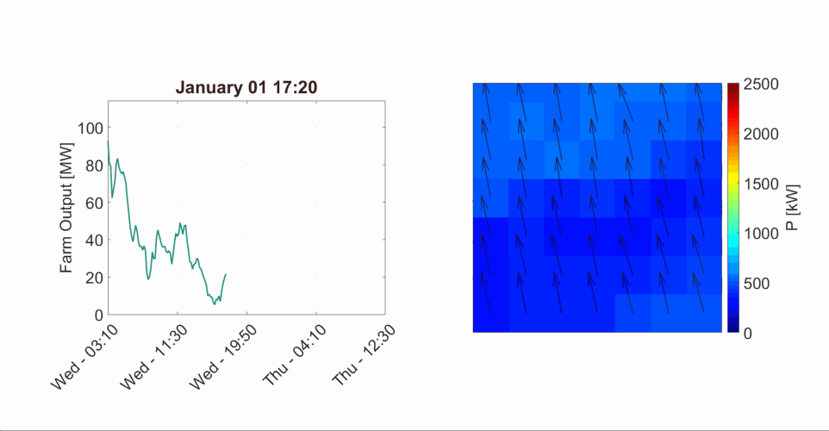
Real-time monitoring
Wind farm power layout

Slide 9
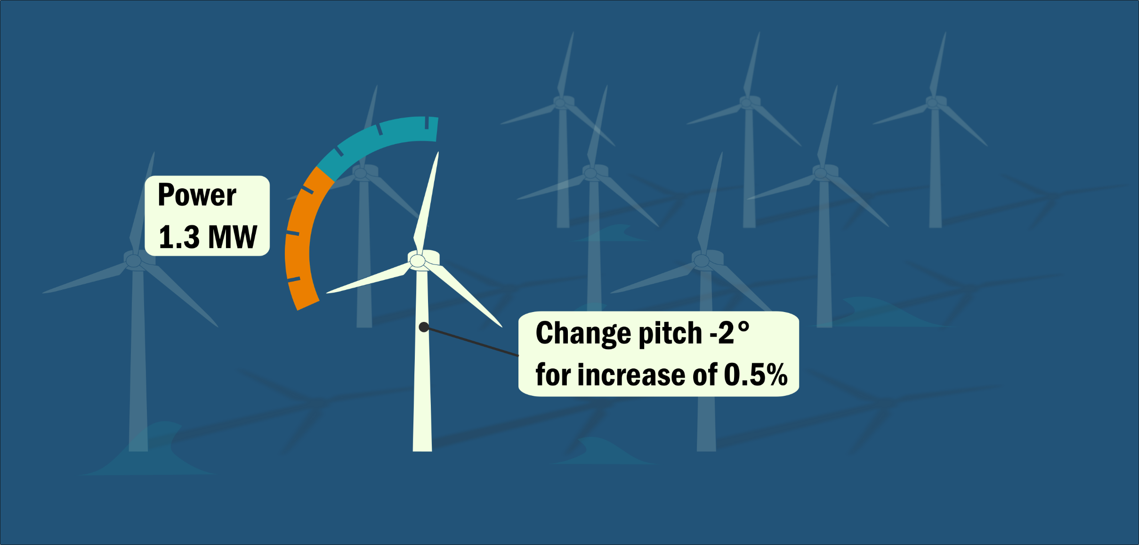

Real-time monitoring

Slide 10
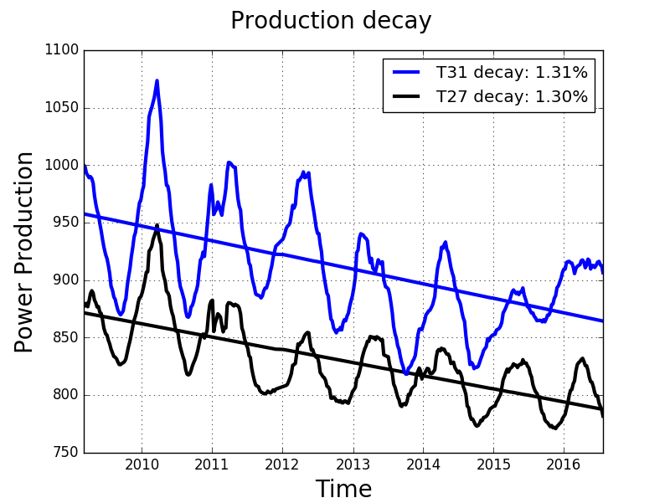
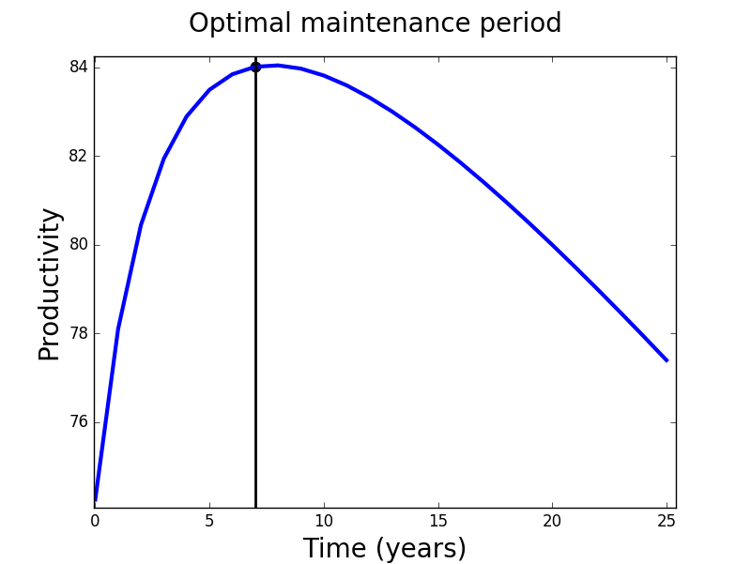
Maintenance
Production decay
Optimal Maintenance Period
Notes:
Decay plot on the left, maintenance prediction on the right

Slide 11
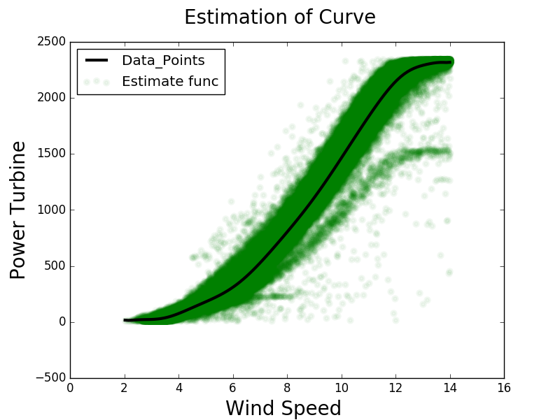
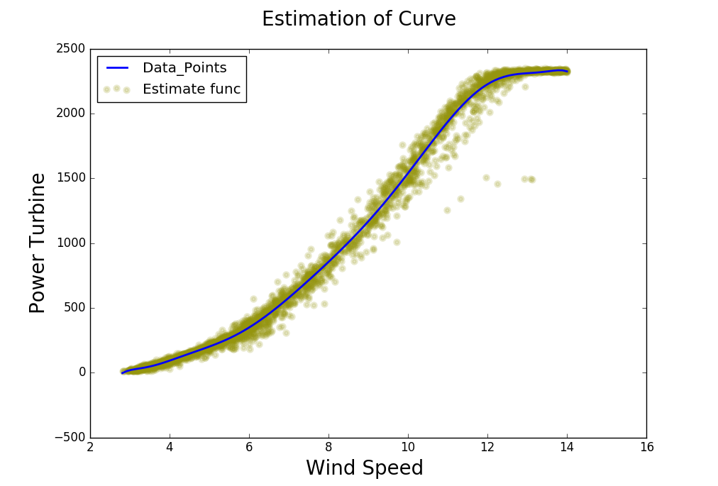
Accurate Predictions
Naïve model
Our model

Slide 12
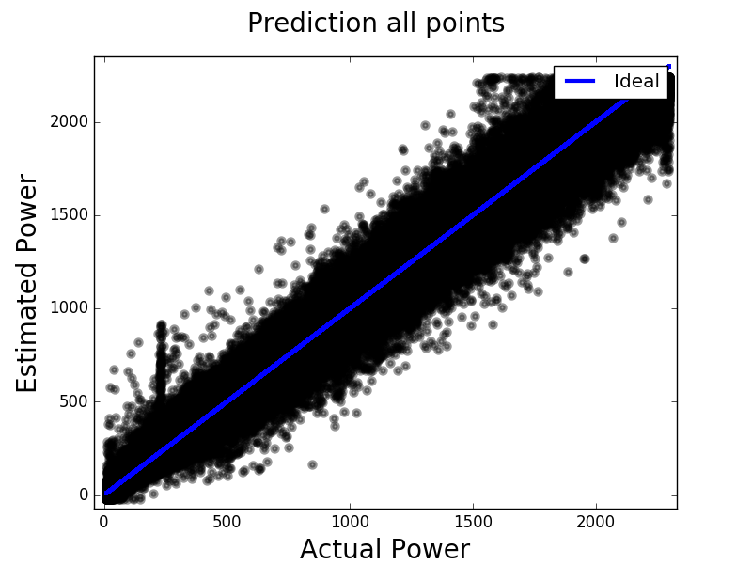
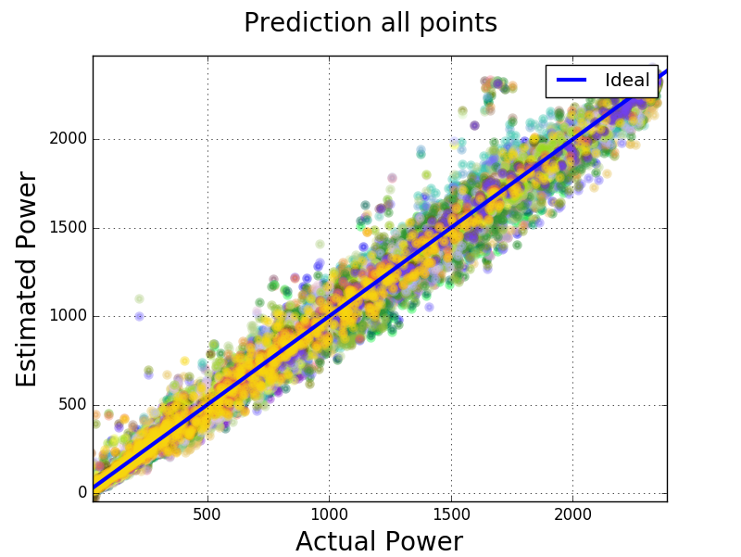
Accurate Predictions
Naïve model
Our model

Slide 13
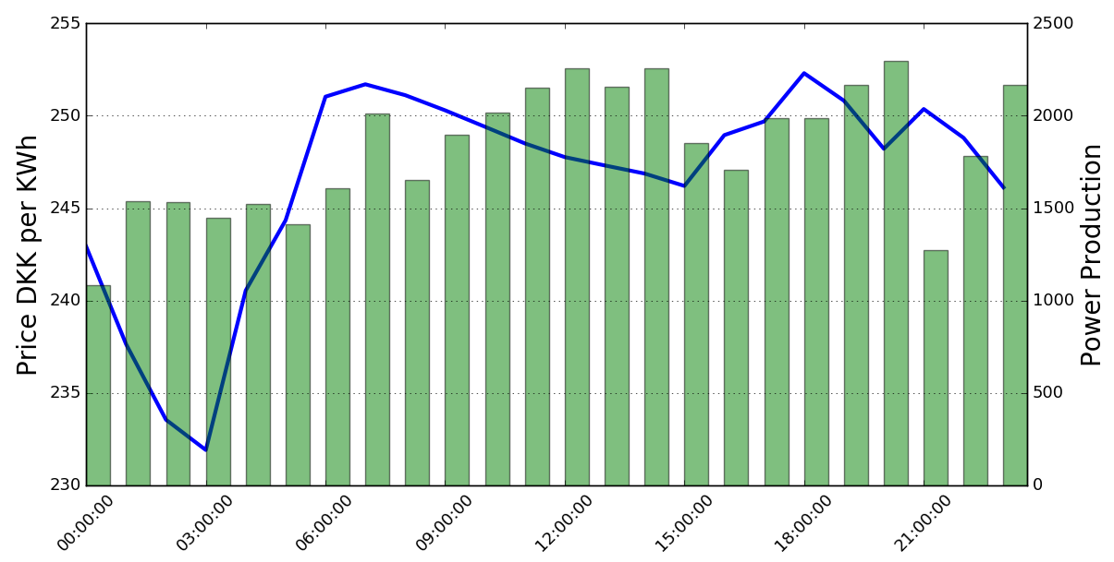
Market Connection

Slide 14



Business Model
Farm Operator
Service Subscription
Web app
Data Collection
Market
Weather
Wind Farm

Slide 15
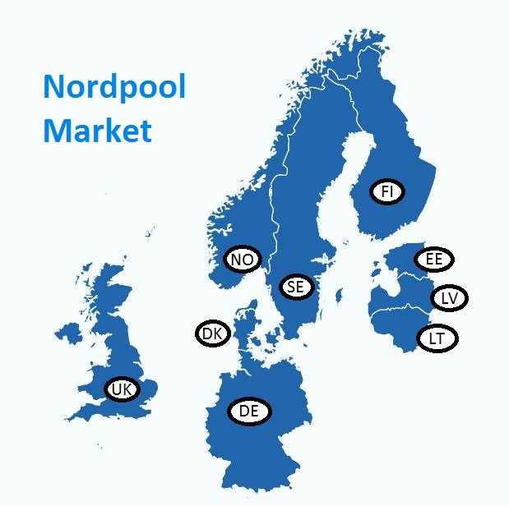


Market
489 TWh
~10 Billion €
>14% Wind Energy

Slide 16




Our Team
SMART ONE

